Slide 1
CS 171 ch 6 Mining frequent patterns, associations, and correlations: Basic concepts and methods
Transcribed by Charlie seager

Slide 2
Basic concepts
Frequent pattern mining searches for recurring relationships in a given data set. This section introduces the basic concepts of frequent pattern mining for the discovery of interesting associations and correlations between item sets in transactional and relational databases. We begin section 6.1.1 by presenting an example of market basket analysis, the earliest form of frequent pattern mining for associations rules.

Slide 3
Market Basket Analysis: A motivating example
Frequent itemset mining leads to the discovery of associations and correlations among items in large transactional or relational data sets.
A typical example of frequent itemset mining is market basket analysis. This process analyzes customer buying habits by finding associations between the different items that customers place in their “shopping baskets”
The discovery of these associations can help retailers develop marketing strategies by gaining insight into which items are frequently purchased together by customers
For example if customers are buying milk, how likely are they to also buy bread (and what kind of bread) on the same trip

Slide 4
Frequent itemsets, closed itemsets, and association rules
Refer to textbook: pg 246
https://myweb.sabanciuniv.edu/rdehkharghani/files/2016/02/The-Morgan-Kaufmann-Series-in-Data-Management-Systems-Jiawei-Han-Micheline-Kamber-Jian-Pei-Data-Mining.-Concepts-and-Techniques-3rd-Edition-Morgan-Kaufmann-2011.pdf

Slide 5
Frequent itemset mining methods: ch 6.2
For this section you will learn methods for mining the simplest form of frequent patterns such as those discussed for market basket analysis in section 6.1.1
We begin by presenting Apiori the basic algorithm for finding itemsets. Section 6.2.3 describes several variations to the Apiori algorithm for improved efficiency and scalability. Section 6.2.4 presents pattern growth methods for mining the current frequent itemsets. Section 6.2.5 presents methods for mining frequent itemsets that take advantage of the vertical data format

Slide 6
6.2.1 Apriori algorithm: Finding frequent itemsets by confined generation
Apriori is a seminal algorithm proposed by R. Agrawal and R. Srikant in 1994 for mining frequent itemsets for Boolean association rules.
The name of the algorithm is based on the fact that the algorithm uses prior knowledge of frequent itemset properties, as we shall see later.
Apriori employs an iterative approach known as a level-wise search, where k-itemsets are used to explore (k+1)
First, the set of frequent 1-itemsets is found by scanning the database to accumulate the count for each item and collecting those items that satisfy minimum support. The resulting set is denoted by L_1. Next L_1 is used to find L_2, the set of frequent 2-itemsets, which is used to find L_3 and so on, until no more frequent k-itemsets can be found. The finding of each L_k requires one full scan of the database
To improve the efficiency of the level wise generation of frequent itemsets, an important property called the Apriori property is used to reduce the search space

Slide 7
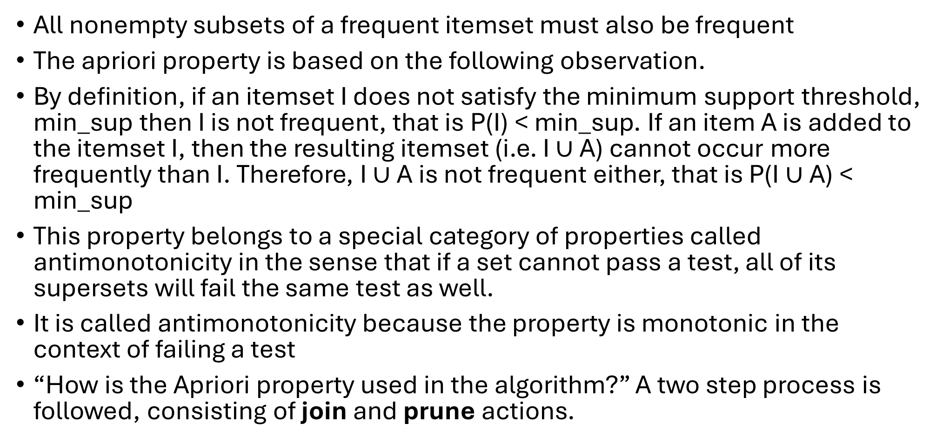
Apriori property:
All nonempty subsets of a frequent itemset must also be frequent
The apriori property is based on the following observation.
By definition, if an itemset I does not satisfy the minimum support threshold, min_sup then I is not frequent, that is P(I) < min_sup. If an item A is added to the itemset I, then the resulting itemset (i.e. I $∪$ A) cannot occur more frequently than I. Therefore, I $∪$ A is not frequent either, that is P(I $∪$ A) < min_sup
This property belongs to a special category of properties called antimonotonicity in the sense that if a set cannot pass a test, all of its supersets will fail the same test as well.
It is called antimonotonicity because the property is monotonic in the context of failing a test
“How is the Apriori property used in the algorithm?” A two step process is followed, consisting of join and prune actions.

Slide 8
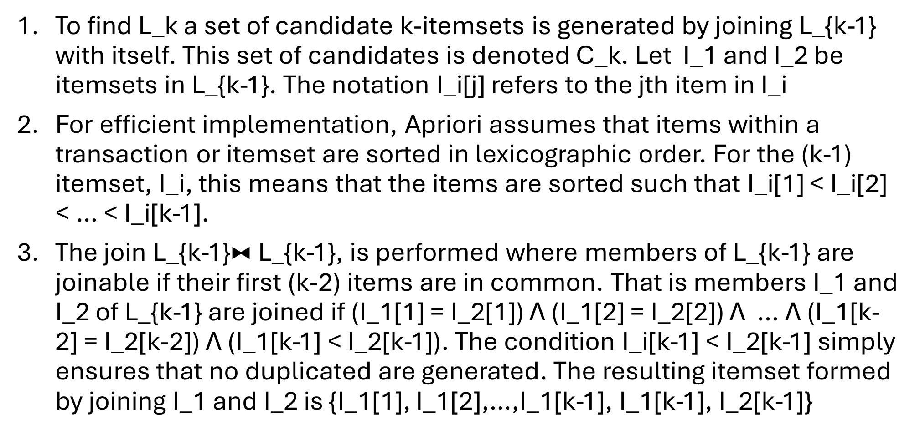
Join step
To find L_k a set of candidate k-itemsets is generated by joining L_{k-1} with itself. This set of candidates is denoted C_k. Let I_1 and I_2 be itemsets in L_{k-1}. The notation I_i[j] refers to the jth item in I_i
For efficient implementation, Apriori assumes that items within a transaction or itemset are sorted in lexicographic order. For the (k-1) itemset, I_i, this means that the items are sorted such that I_i[1] < I_i[2] < … < I_i[k-1].
The join L_{k-1}$⧓$ L_{k-1}, is performed where members of L_{k-1} are joinable if their first (k-2) items are in common. That is members I_1 and I_2 of L_{k-1} are joined if (I_1[1] = I_2[1]) Λ (I_1[2] = I_2[2]) Λ … Λ (I_1[k-2] = I_2[k-2]) Λ (I_1[k-1] < I_2[k-1]). The condition I_i[k-1] < I_2[k-1] simply ensures that no duplicated are generated. The resulting itemset formed by joining I_1 and I_2 is {I_1[1], I_1[2],…,I_1[k-1], I_1[k-1], I_2[k-1]}

Slide 9
Prune Step
C_k is a superset of L_k that is, its members may or may not be frequent, but all of the frequent k-itemsets are included in C_k.
A database scan to determine the count of each candidate in C_k would result in the determination of L_k (i.e. all candidates having a count no less than the minimum support count are frequent by definitions and therefore belong to L_k). C_k however, can be huge, and so this could involve heavy computation. To reduce the size of C_k, the Apriori property is used as follows
Any (k-1) itemset that is not frequent cannot be a subset of a frequent k-itemset. Hence, if any (k-1)-subset of a candidate k-itemset is not in L_{k-1}, then the candidate cannot be frequent either and so can be removed from C_k.
This subset testing can be done quickly by maintaining a hash tree of all frequent itemsets

Slide 10
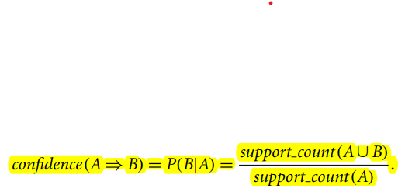
6.2.2 Generating association rules from frequent itemsets
Once the frequent itemsets form transactions in a database D have been found, it is straightforward to generate strong association rules from them (where strong association rules satisfy both minimum support and minimum confidence)

Slide 11
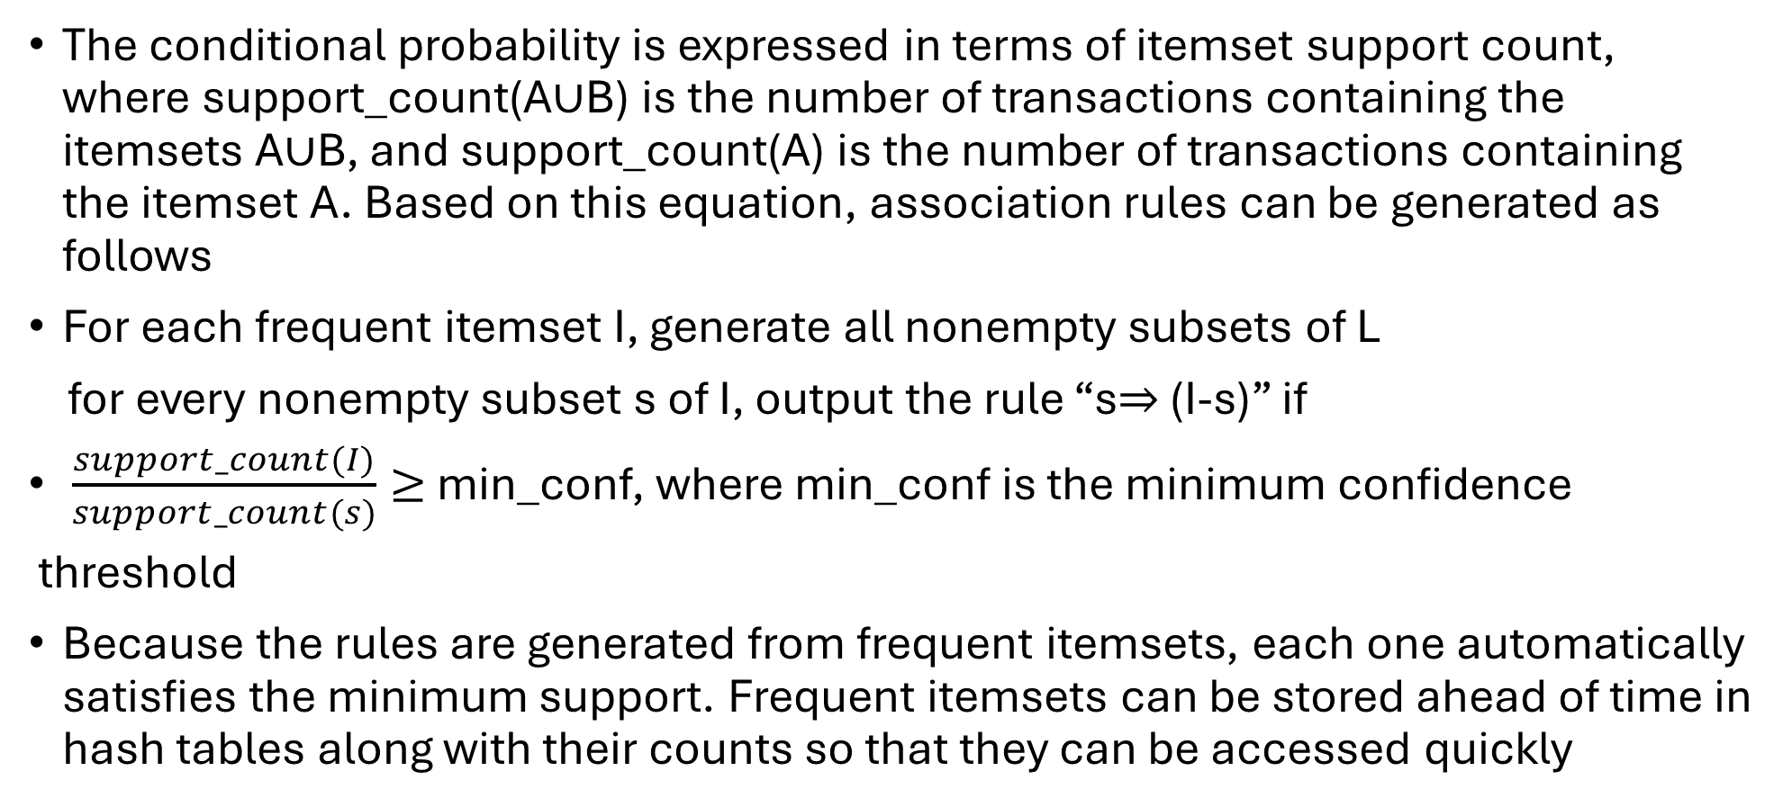
Generating Association rules from frequent itemsets
The conditional probability is expressed in terms of itemset support count, where support_count(A$∪$B) is the number of transactions containing the itemsets A$∪$B, and support_count(A) is the number of transactions containing the itemset A. Based on this equation, association rules can be generated as follows
For each frequent itemset I, generate all nonempty subsets of L
for every nonempty subset s of I, output the rule “s$⇒$ (I-s)” if
$\frac{support_count(I)}{support_count(s)}≥$ min_conf, where min_conf is the minimum confidence
threshold
Because the rules are generated from frequent itemsets, each one automatically satisfies the minimum support. Frequent itemsets can be stored ahead of time in hash tables along with their counts so that they can be accessed quickly

Slide 12
6.2.3 Improving the efficiency of Apriori
“How can we further improve the efficiency of Apriori-based mining?” Many variations of the Apriori algorithm have been proposed that focus on improving the efficiency of the original algorithm

Slide 13
Hash based technique
(hashing itemsets into corresponding buckets): A hash based technique can be used to reduce the size of the candidate k-itemsets, C_k for k > 1.
For example, when scanning each transaction in the database to generate the frequente I-itemsets L_1, we can generate all the 2-itemsets for each transaction hash (i.e. map) them into the different buckets of a hash table structure, and increase the correspondening bucket counts
A 2-itemset with a corresponding bucket count in the hash table that is below the support threshold cannot be frequent and thus should be removed from the candidate set.
Such a hash-based technique may substantially reduce the number of candidate k-itemsets examined (especially when k=2)

Slide 14
Transaction reduction
(reducing the number of transactions scanned in future iterations)
A transaction that does not contain any frequent k-itemset cannot contain any frequent (k+1)-itemsets.
Therefore, such a transaction can be marked or removed from further consideration because subsequent database scans for j-itemsets, where j>k, will not need to consider such a transaction

Slide 15
Partitioning
(partitioning the data to find candidate itemsets)
A partitioning technique can be used that requires just two database scans to mine the frequent itemsets
It consists of two phases. In phase 1, the algorithm divides the transactions of D into n nonoverlapping partitions. If the minimum support count for a partition is min_sup x the number of transactions in that partition. For each partition all the local frequent itemsets (i.e. the itemsets frequent within the partition) are found
A local frequent itemset may or may not be frequent with respect to the entire database D, However any itemset that is potentially frequent with respect to D must occur as a frequent itemset in at least one of the partitions. Therefore all local frequent itemsets are candidate itemsets with respect to D. The collection of frequent itemsets from all partiions forms the global candidate itemsets with respect to D.
In phase 2, a second scan of D is conducted in which the actual support of each candidate is assessed to determine the global frequent itemsets. Partition size and the number of partitions are set so that each partition can fit into main memory and therefore be read only once in each phase

Slide 16
Sampling
(mining on a subset of the given data)
The basic idea of the sampling approach is to pick a random sample S of the given data D, and then search for frequent itemsets in S instead of D. In this way we trade off some degree of accuracy against efficiency.
The S sample size is such that the search for frequent itemsets in S can be done in main memory, and so only one scan of the transactions in S is required overall.
Because we are searching for frequent itemsets in S rather than in D, it possible that we will miss some of the global frequent itemsets

Slide 17
Sampling pt 2
To reduce this possibility we use a lower support threshold than minimum support to find the frequent itemsets local to S (denoted L^S).
The rest of the database is then used to compute the actual frequencies of each itemset in L^S. A mechanism is used to determine whether all the global frequent itemsets are included in L^S. If L^S actually contains all the frequent itemsets in D, then only one scan of D is required
Otherwise, a second pass can be done to find the frequent itemsets that were missed in the first pass.
The sampling approach is espically benefincial when efficiency is of utmost importance such as in computationally intensive application that must be run frequently

Slide 18
Dynamic itemset counting
(adding candidate itemsets at different points during a scan):
A dynamic itemset counting technique was proposed in which the database is partitioned into blocks marked by start points.
In this variations, new candidate itemsets can be added at any start point, unlike in Apriori, which determines new candidate itemsets only immediately before each complete database scan.
The technique uses the count-so-far as the lower bound of the actual count
If the count-so=far passes the minimum support, the itemset is added into the frequent itemset collection and can be used to generate longer candidates. This leads to fewer database scans than with Apriori for finding all the frequent itemsets

Slide 19
6.2.4 A pattern-growth approach for mining frequent itemsets
In many cases the Apriori candidate generate and test method significantly reduces the size of candidate sets, leading to good performance gain. However it can suffer from two nontrivial costs
It may still need to generate a huge number of candidate sets. For example if there are 10^4 frequent 1-itemsets, the Apriori algorithm will need to generate more than 10^7 candidate 2-itemsets
It may need to repeatedly scan the whole database and check a large set of candidates by pattern matching. It is costly to go over each transaction in the database to determine the support of the candidate itemsets

Slide 20
6.2.4
“Can we design a method that mines the complete set of frequent itemsets without such a costly candidate generation process?” An interesting method in this attempt is called frequent pattern growth, or simply FP-growth, which adopts a divide and conquer strategy as follows. First it compresses the database representing frequent items into a frequent pattern tree, or FP-tree, which retains the itemset assocaiton information.
It then divides the compressed database into a set of conditional databases (a special kind of projected database), each associated with one frequent item or “pattern fragment” and mines each database separately. For each “pattern fragment” only its assocaicted data sets needs to be examined. Therefore this approach may substantially reduce the size of data sets to be searched, along with the “growth” patterns being examined

Slide 21
6.2.5 Mining frequent itemsets using the vertical data format
Both the Apriori and FP-growth methods mine frequent patterns from a set of transactions in TID-itemset format (i.e. {TID : itemset} ), where TID is a transaction ID and itemset is the set of items bought in transaction TID. This is known as the horizontal data format
Alternatively, data can be presented in item-TID_set format

Slide 22
FP-growth algorithm
Algorithm FP-growth: mine frequent itemsets using an FP-tree by pattern fragment growth
Input:
D, a transaction database
Min_sup, the minimum support count threshold
Output the complete set of frequent patterns

Slide 23
Methods of the FP-growth algorithm
1. The FP-tree is constructed in the following steps:
A) Scan the transaction database D once. Collect F, the set of frequent items and their support counts. Sort F in support count descending order as L, the list of frequent items
Create the root of an FP-tree, and label it as “null”. For each transaction Trans in D do the following.
Select and sort the frequent items in Trans according to the order of L. Let the sorted freqeutn item list in Trans be [p|P] where p is the first element and P is the remaing list. Call insert_tree ([p|P], T), which is performed as follows
If T has a child N such that N.item-name = p.item-name, then increment N’s count by 1; else create a new node N, and let its count be 1, its parent link be linked to T, and its node-link to the nodes with the same item-name via the node link structure
If p is nonempty, call insert_tree(P,N) recursively

Slide 24
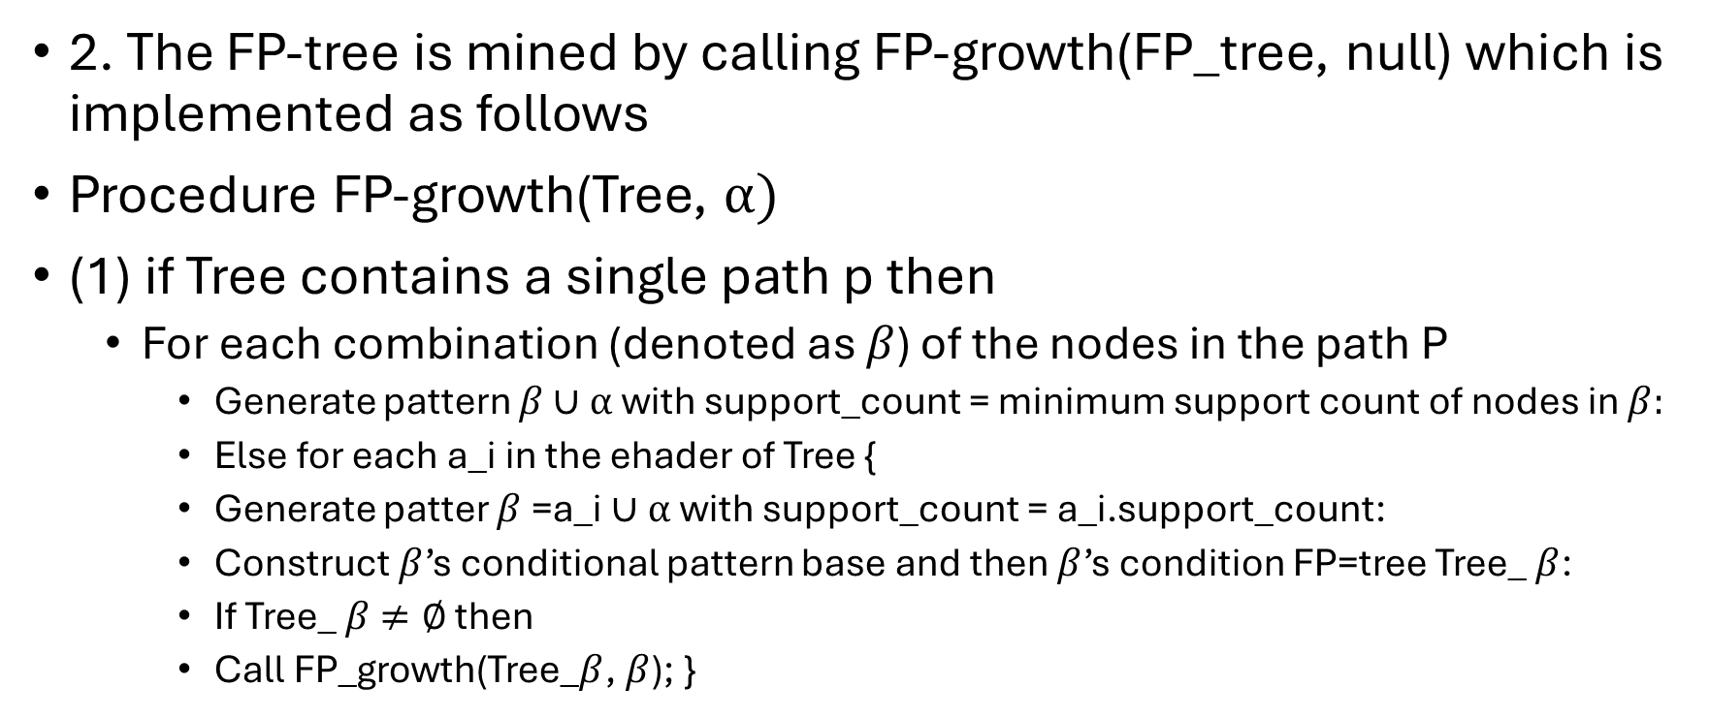
Methods of the FP-growth algorithm pt 2
2. The FP-tree is mined by calling FP-growth(FP_tree, null) which is implemented as follows
Procedure FP-growth(Tree, $α)$
(1) if Tree contains a single path p then
For each combination (denoted as $β$) of the nodes in the path P
Generate pattern $β∪α$ with support_count = minimum support count of nodes in $β:$
Else for each a_i in the ehader of Tree {
Generate patter $β$=a_i $∪α$ with support_count = a_i.support_count:
Construct $β$’s conditional pattern base and then $β$’s condition FP=tree Tree_ $β$:
If Tree_ $β$ $≠∅$ then
Call FP_growth(Tree_$β$, $β$); }

Slide 25
6.2.6 Mining closed and max patters
“How can we mine closed frequent itemsets?” A naïve approach would be to first mine the complete set of frequent itemsets and then remove every frequent itemset that is a proper subset of, and carries the same support as, an existing frequent itemset. However this is quite costly.
A recommended methodology is to search for closed frequent itemsets directly during the mining process. This requires us to prune the search space as soon as we can identify the case of closed itemsets during mining. Pruning strategies include the following:

Slide 26
Item-Merging
If every transaction containing a frequent itemset X also contains an itemset Y but not any proper superset of Y, then X ∪ Y forms a freqeuent closed itemset and there is no need to search for any itemset containing X but no Y
For example in Table 6.2 fo example 6.5, the projected conditional database for prefix itemset {I5:2} is {{I2, I1}, {I2, I1, I3}}, from which we can see that each of its transactions contains itemset {I2, I1} but no proper subset of {I2, I1}. Itemset {I2, I1} can be merged with {I5} to form the closed itemset {I5, I2, I1: 2} and we do not need to mine for closed itemsets that contain I5 but not {I2, I1}

Slide 27
Sub-itemset Pruning:
If a frequent itemset X is a proper subset of an already found frequent closed itemset Y and support_count(X)= support_count(Y), then X and all of X”s descendants in the set enumeration tree cannot be frequent closed itemsets and thus can be pruned

Slide 28
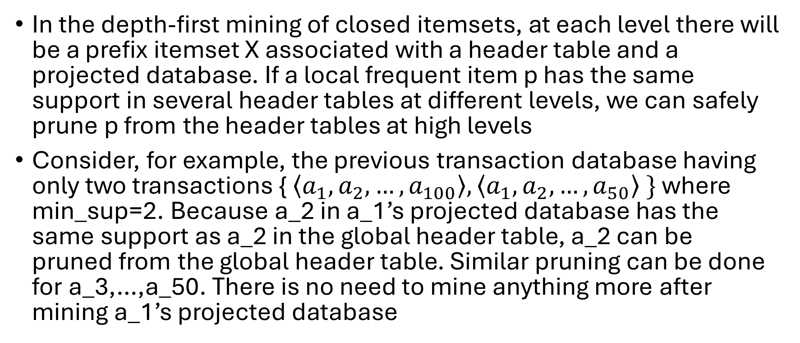
Item skipping
In the depth-first mining of closed itemsets, at each level there will be a prefix itemset X associated with a header table and a projected database. If a local frequent item p has the same support in several header tables at different levels, we can safely prune p from the header tables at high levels
Consider, for example, the previous transaction database having only two transactions { $\left\langle a_{1}, a_{2},…,a_{100}\right\rangle , \left\langle a_{1}, a_{2},…,a_{50}\right\rangle \}$ where min_sup=2. Because a_2 in a_1’s projected database has the same support as a_2 in the global header table, a_2 can be pruned from the global header table. Similar pruning can be done for a_3,…,a_50. There is no need to mine anything more after mining a_1’s projected database

Slide 29
FYI
Superset checking: which checks if this new frequent itemset is a superset of some already found closed itemsets with the same support and
Subset checking: which checks whether the newly found itemset is a subset of an already found closed itemset with the same support
A two level hash index structure can be built for fast accessing of the pattern tree

